Slide 1
19ECE204
Lecture 12

Slide 2
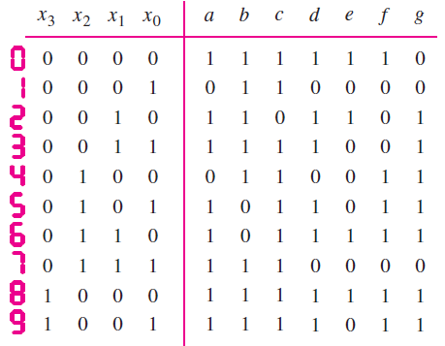
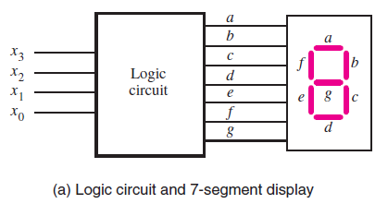
Example 3
Design a circuit which takes a four-bit binary number X = x₃x₂x₁x₀ that represents the decimal values 0, 1, . . . , 9 and display the same.
Sol : Using four bits to represent decimal digits in this way is often referred to as the binary coded decimal (BCD) representation.
The figure shows the inputs (x₃ , x₂ , x₁ , x₀) and the 7 segment outputs (a, b, . . . , g) that control the display.

Slide 3
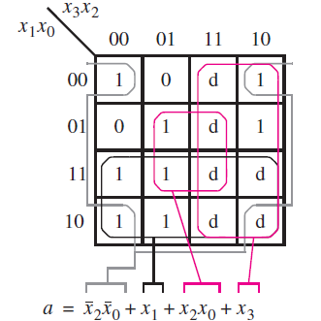
Contd.
From, the truth table, one can see that, since X is restricted to decimal digits, then the values of X from 1010 to 1111 are not used.
These entries are omitted from the truth table and can be treated as don’t cares in the design of the circuit.
The logic expressions for the outputs a to g, can be derived using K- maps. But, here we discuss for a and e only
Figure gives Karnaugh maps
for the function a.
Assuming all d as 1, we get the minimum cost
implementation for a as,

Slide 4
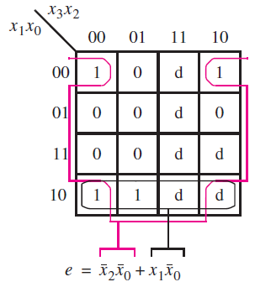
Contd.
K-map for e is shown.
For optimal simplification, we can set don’t cares corresponding to m₁₁ and m₁₄ only as 1 and rest as 0.
Thus, the minimum cost expression is,
Similarly, find out the least cost expressions
for the other segments b,c,d,f and g as an
exercise. Also find the minimum cost POS
implementations of all segments.

Slide 5


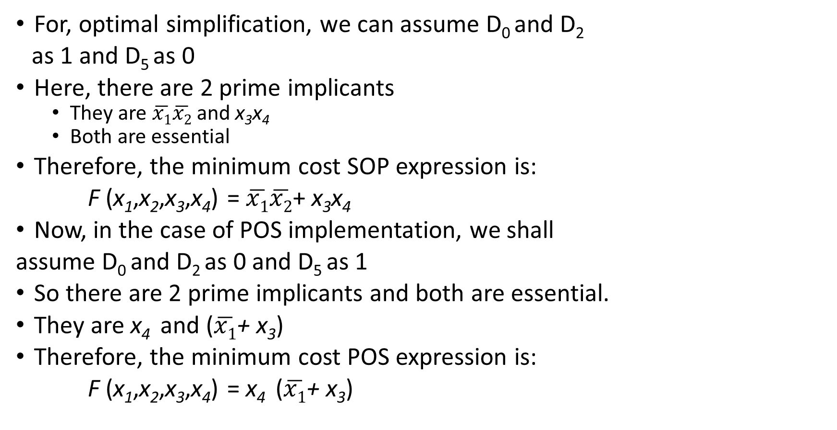
Example 4: F (x₁,x₂,x₃,x₄) = Σm(1, 3, 7, 11, 15) which has the don’t-care conditions D (x₁,x₂,x₃,x₄) = Σ(0, 2, 5)
For, optimal simplification, we can assume D₀ and D₂
as 1 and D₅ as 0
Here, there are 2 prime implicants
They are $\overline{x1}\overline{x2}$ and x₃x₄
Both are essential
Therefore, the minimum cost SOP expression is:
F (x₁,x₂,x₃,x₄) = $\overline{x1}\overline{x2}$+ x₃x₄
Now, in the case of POS implementation, we shall
assume D₀ and D₂ as 0 and D₅ as 1
So there are 2 prime implicants and both are essential.
They are x₄ and ($\overline{x1}$+ x₃)
Therefore, the minimum cost POS expression is:
F (x₁,x₂,x₃,x₄) = x₄ ($\overline{x1}$+ x₃)
d
1 | d
1 | 1 | 1 | 1
d
d | 0 | 0 | 0
1 | d | 0 | 0
1 | 1 | 1 | 1
d | 0 | 0 | 0

Slide 6
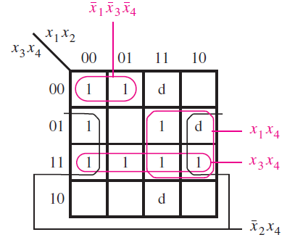
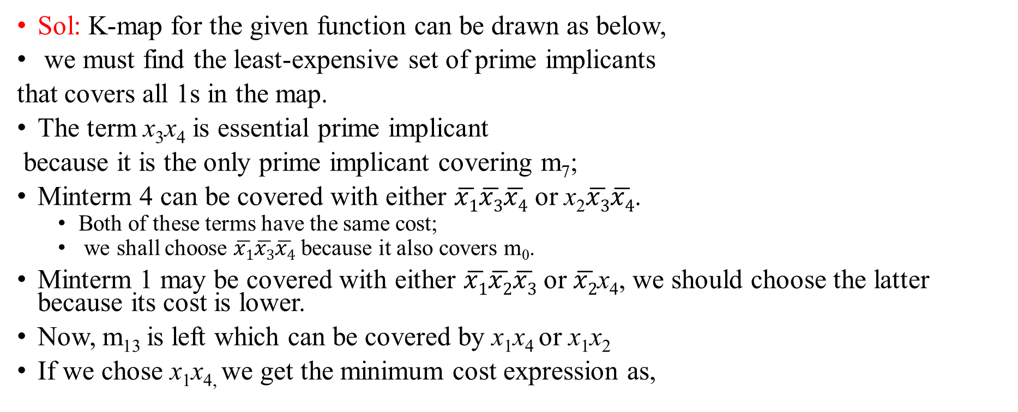
Example 5: Use Karnaugh maps to find the minimum-cost SOP and POS expressions for the given function assuming that there are also don’t-cares defined as D =Σ(9, 12, 14).
Sol: K-map for the given function can be drawn as below,
we must find the least-expensive set of prime implicants
that covers all 1s in the map.
The term x₃x₄ is essential prime implicant
because it is the only prime implicant covering m₇;
Minterm 4 can be covered with either $\overline{x1}\overline{x3}\overline{x4}$ or x₂$\overline{x3}\overline{x4}$.
Both of these terms have the same cost;
we shall choose $\overline{x1}\overline{x3}\overline{x4}$ because it also covers m₀.
Minterm 1 may be covered with either $\overline{x1}\overline{x2}\overline{x3}$ or $\overline{x2}$x₄, we should choose the latter because its cost is lower.
Now, m₁₃ is left which can be covered by x₁x₄ or x₁x₂
If we chose x₁x_{4,} we get the minimum cost expression as,

Slide 7
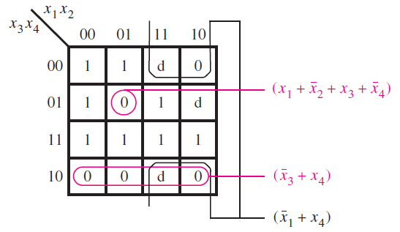
Contd. (POS implementation)
K-map for the POS form can be drawn as given,
Convenient values for d can be assumed,
Finally, we get the minimum cost POS implementation as below,

